Slide 1
Modular Programming With Functions
C & C++

Slide 2
Modularity
How do you solve a big/complex problem?
Divide it into small tasks and solve each task. Then combine these solutions.
Divide and Conquer

Slide 3
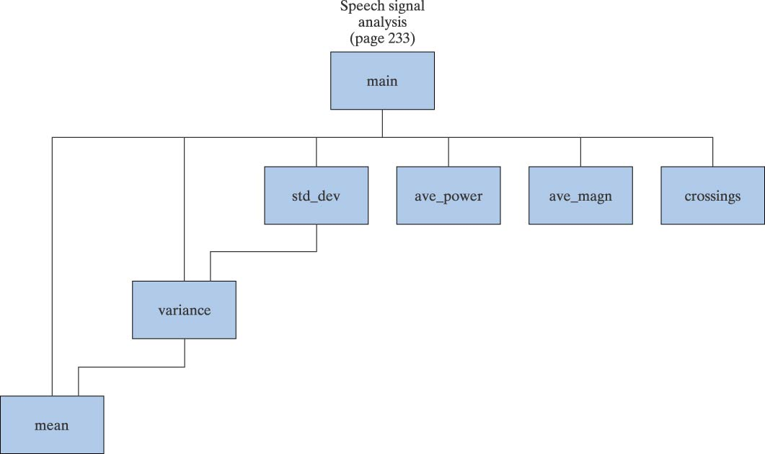
Modularity (cont’d)
In C we use functions also referred to as modules to perform specific tasks that we determined in our solution
Structure Chart
Shows how the program separated into tasks and which tasks reference other tasks.
NOTE: It does NOT indicate the sequence of steps in the program!

Slide 4
Advantages of using modules
Modules can be written and tested separately
Modules can be reused
Large projects can be developed in parallel
Reduces length of program, making it more readable
Promotes the concept of abstraction
A module hides details of a task
We just need to know what this module does
We don’t need to know how it does it

Slide 5
Programmer Defined Functions
Every C program starts with main()function
Additional functions are called or invoked when the program encounters function names
Functions could be
Pre-defined library functions (e.g., printf, sin, tan) or
Programmer-defined functions (e.g., my_printf, area)
Functions
Perform a specific task
May take arguments
May return a single value to the calling function
May change the value of the function arguments (call by reference)

Slide 6
Function definition
return_type function_name (parameters)
{
declarations;
statements;
}
int my_add_func(int a, int b)
{
int sum;
sum = a + b;
return sum;
}

Slide 7
Programmer-Defined Functions Terminology
Function Prototype describes how a function is called
int my_add_func(int a, int b);
Function Call
result = my_add_func(5, X);
Function implementation
int my_add_func(int a, int b)
{
…
}
Function parameters
Formal parameters
Actual parameter
Formal parameters must match with actual parameters in order, number and data type.
If the type is not the same, type conversion will be applied (coercion of arguments). But this might cause some errors (double→int) so you need to be careful!

Slide 8
Example: Pre-defined Functions
So far, we used several pre-defined functions!
#include <stdio.h>
#include <math.h>
int main(void)
{
double angle;
printf(“Input angle in radians: \n“);
scanf(“%lf”, &angle);
printf(“The sine of the angle is %f\n“,
sin(angle) );
return 0;
}
double sin(double radian);
double sin(double radian)
{
/* details of computing sin */
}

Slide 9
Example: Programmer-defined Functions
#include <stdio.h>
int main(void)
{
double x1,y1,x2,y2, dist;
printf(“Enter x1 y1 x2 y2 :”);
scanf(“%lf %lf %lf %lf”, &x1,&y1,&x2,&y2);
dist = sqrt(pow((x2-x1),2)
+ pow((y2-y1),2));
printf(“Distance is %lf\n”, dist);
return 0;
}
#include <stdio.h>
double distance(double x1,y1,x2,y2);
int main(void)
{
double x1,y1,x2,y2, dist;
printf(“Enter x1 y1 x2 y2 :”);
scanf(“%lf %lf %lf %lf”, &x1,&y1,&x2,&y2);
dist = distance(x1,y1,x2,y2);
printf(“Distance is %lf\n”, dist);
return 0;
}
double distance(double x1,y1,x2,y2)
{
return sqrt(pow((x2-x1),2)
+ pow((y2-y1),2));
}

Slide 10
Exercise
(6,8)
(-3,5)
(4,-1)
Suppose you are given the coordinate points of a triangle as shown above, write a program that can find the length of each edge…
User enters: (x1, y1), (x2, y2), and (x3, y3)

Slide 11
Value Returning Functions
Function returns a single value to the calling program
Function definition declares the type of value to be returned
A return expression; statement is required in the function definition
The value returned by a function can be assigned to a variable, printed, or used in an expression

Slide 12
Void Functions
A void function may be called to
perform a particular task (clear the screen)
modify data
perform input and output
A void function does not return a value to the calling program
A return; statement can be used to exit from function without returning any value

Slide 13
Exercise: void function
Write a program to generate the following output?
#include <stdio.h>
void print_i_star(int i);
main()
{
int i;
for (i=1; i<=5; i++) {
print_i_star( i );
}
}
void print_i_star(int i)
{
int j;
for (j=1; j<=i; j++)
printf(“*”);
printf(“\n”);
return;
}
*
**
***
****
*****
for (i=1; i<=5; i++) {
for (j=1; j<=i; j++)
printf(“*”);
printf(“\n”);
}

Slide 14
Example: value returning function
n!=n*(n-1)*…*1, 0! = 1 by definition
Function name
Return Type
int fact(int n)
{
int factres = 1;
while(n>1)
{
factres = factres*n;
n--;
}
return(factres);
}
Parameter Declarations
Declarations
Statements

Slide 15
Example – use fact()
#include <stdio.h>
int fact(int n); /* prototype */
int main(void)
{
int t= 5,s;
s = fact(t) + fact(t+1);
printf(“result is %d\n”, s);
return 0;
}
t = 5
s = ?
Function call

Slide 16
Example – execution of factorial function (cont’d)
fact( 5 )
int fact(int n)
{
int factres = 1;
while(n>1)
{
factres = factres*n;
n--;
}
return(factres);
}
t = 5
s = ?
n = 5
factres = 1

Slide 17
Example – execution of factorial function (cont’d)
int fact(int n)
{
int factres = 1;
while(n>1)
{
factres = factres*n;
n--;
}
return(factres);
}
t = 5
s = ?
n = 5 4 3 2 1
factres = 1 5 20 60 120

Slide 18
Example – execution of factorial function (cont’d)
#include <stdio.h>
int fact(int n); /* prototype */
int main(void)
{
int t= 5,s;
s = 120 + fact(t+1);
printf(“result is %d\n”, s);
return 0;
}
t = 5
s = ?
Function call

Slide 19
Example – execution of factorial function (cont’d)
fact( 6 )
int fact(int n)
{
int factres = 1;
while(n>1)
{
factres = factres*n;
n--;
}
return(factres);
}
t = 5
s = ?
n = 6
factres = 1
t+1

Slide 20
Example – execution of factorial function (cont’d)
int fact(int n)
{
int factres = 1;
while(n>1)
{
factres = factres*n;
n--;
}
return(factres);
}
t = 5
s = ?
n = 6 5 4 3 2 1
factres = 1 6 30 120 360 720

Slide 21
Example – execution of factorial function (cont’d)
#include <stdio.h>
int fact(int n); /* prototype */
int main(void)
{
int t= 5,s;
s = 120 + 720;
printf(“result is %d\n”, s);
return 0;
}
t = 5
s = 840
result is 840

Slide 22
Example – reuse of factorial function
Write a statement to compute
Enter X, Z, K, D
…
y=(fact(X)+fact(Z)*5)/(fact(K)-fact(D));

Slide 23
Example – reuse of factorial function in another function
Write a select function that takes n and k and computes “n choose k” where
int select(int n, int k)
{
return fact(n)/(fact(n-k)*fact(k));
}

Slide 24
Exercise
Write a function to compute maximum and minimum of two numbers
int max(int a, int b)
{
if (a > b)
return a;
else
return b;
}
int min(int a, int b)
{
if (a < b)
return a;
else
return b;
}

Slide 25
Exercise
Are following calls to max function valid?
What will be the result?
int max(int a, int b);
int min(int a, int b);
int main()
{
int x = 2, y = 3, z = 7, temp;
temp = max(x,y);
temp = max(4,6);
temp = max(4,4+3*2);
temp = max(x,max(y,z));
}

Slide 26
Example for void function
void print_date(int mo, int day, int year)
{
/*output formatted date */
printf(“%i/%i/%i\n”, mo, day, year );
return;
}

Slide 27
Exercise
Write a function that takes score as parameter and computes and returns letter grade based on the scale below.
80-100 A
60-79 B
40-59 C
0-39 D

Slide 28
Solution
char get_letter_grade(int score)
{
char grade;
if ((score >= 80) && (score <=100))
grade = 'A';
else if ((score >= 60) && (score <= 79))
grade = 'B';
else if ((score >= 40) && (score <= 59))
grade = 'C';
else if ((score >= 0) && (score <= 39))
grade = 'D';
return grade;
}

Slide 29
Exercise
Write a function to compute log_{b}a
double log_any_base(double a, double b)
{
return log(a)/log(b);
}

Slide 30
Exercise: Trace functions
What is the output of the following program
#include <stdio.h>
int function1(int x)
{
x = 2;
printf("Out1 = %d\n",x);
return(x+1);
}
int main()
{
int x = 4, y;
y = function1(x);
printf("Out2 = %d\n",x);
printf("Out3 = %d\n",y);
return 0;
}
Output
Out1 = 2
Out2 = 4
Out3 = 3

Slide 31
Exercise
What is the output of the following program
#include <stdio.h>
void function2()
{
printf("In function 2\n");
}
void function1()
{
function2();
printf("In function 1\n");
}
void function3()
{
printf("In function 3\n");
function2();
}
int main()
{
function1();
function3();
return 0;
}
Output
In function 2
In function 1
In function 3
In function 2

Slide 32
Parameter Passing
Call by value
formal parameter receives the value of the actual parameter
function can NOT change the value of the actual parameter (arrays are an exception)
Call by reference
actual parameters are pointers (ch 5 and 6)
function can change the value of the actual parameter

Slide 33
Scope of a function or variable
Scope refers to the portion of the program in which
It is valid to reference the function or variable
The function or variable is visible or accessible
#include <stdio.h>
int fact(int n); /* prototype */
int main(void)
{
int t= 5,s;
s = fact(t) + fact(t+1);
printf(“result is %d\n”, s);
return 0;
}
int fact(int n)
{
int factres = 1;
while(n>1) {
factres = factres*n;
n--;
}
return(factres);
}
t = 5
s = ?
n = 5
factres = 1

Slide 34
Scope of a function or variable
Same variable name can be used in different functions
#include <stdio.h>
int fact(int n); /* prototype */
int main(void)
{
int t= 5,s;
s = fact(t) + fact(t+1);
printf(“result is %d\n”, s);
return 0;
}
int fact(int t)
{
int s = 1;
while(t>1) {
s = s*t;
t--;
}
return(s);
}
t = 5
s = ?
t = 5
s = 1

Slide 35
Scope
Local scope
a local variable is defined within a function or a block and can be accessed only within the function or block that defines it
Global scope
a global variable is defined outside the main function and can be accessed by any function within the program file.

Slide 36
Global vs Local Variable
#include <stdio.h>
int z = 2;
void function1()
{ int a = 4;
printf("Z = %d\n",z);
z = z+a;
}
int main()
{ int a = 3;
z = z + a;
function1();
printf("Z = %d\n",z);
z = z+a;
return 0;
}
z=2 5 9 12
a=4
a=3
Output
Z = 5
Z = 9

Slide 37
Storage Class - 4 types
Storage class refers to the lifetime of a variable
automatic - key word auto - default for local variables
Memory set aside for local variables is not reserved when the block in which the local variable was defined is exited.
external - key word extern - used for global variables
Memory is reserved for a global variable throughout the execution life of the program.
static - key word static
Requests that memory for a local variable be reserved throughout the execution life of the program. The static storage class does not affect the scope of the variable.
register - key word register
Requests that a variable should be placed in a high speed memory register.

